Slide 1

Center for Advanced Computing
Notes:
Layout = Holding slide A
This is a holding slide, not a title slide. This holding slide is what the audience sees while you are trying to get yourself ready. This is the presentation equivalent of a book cover. There are 3 options for your holding slide. Choose the one that you like best and has the vibe you’re going for.
The images can be changed to as need be. To do this, follow these easy instructions: 1. Click on the image
2. Click on the “Format picture” tab
3. Click on the “Change picture” button
4. Choose the new image from it’s location
5. Scale (holding shift key) as needed
Use wisely. Scale wisely.

Slide 2
Deep Dive into Constructing Containers for Scientific Computing and Gateways: Introduction to Containers
Eric Coulter, Jeremy Fischer, Stephen Bird, Sanjana Sudarshan, Peter Vaillancourt and Suresh Marru
UITS Research Technologies, Indiana University &
Center for Advanced Computing, Cornell University
PEARC20 (Virtual Edition) - July 27, 2020
Notes:
Layout = Title Slide Light
This is a true title slide. Use this slide as you are introducing yourself. Because my title is relatively short, I’ve increased the line spacing on my text block. If your title is long (Craig Stewart comes to mind), keep the line spacing as the template is constructed. It will fit better.

Slide 3
Outline for the day’s events…
Part I
Introduction to container technologies (You are here!)
Simple container creation
Docker to Singularity Conversion
First exercise – building and running a scientific workload with Docker and Singularity
Part II
Complex container build (Matlab Compiler Runtime Environment)
Next steps and best practices
Containers for gateways (including an exercise)
Wrap up

Slide 4
Introduction
…or how I learned to stop worrying and love the bomb containers…

Slide 5
What are containers?
Born from a simple idea (chroot)
Evolved over time into various forms of container services (e.g. BSD Jails, Solaris Zones)
LXC (LinuX Containers) was released in 2008
Docker came on the scene in 2013
Other technologies evolved – Shifter, CharlieCloud, Singularity
Upping the ante – Docker Compose and container orchestration
Notes:
Chroot is an operation that changes the apparent root directory for the current running process and their children. A program that is run in such a modified environment cannot access files and commands outside that environmental directory tree. This modified environment is called a chroot jail.
It gives a user a way to run something in an isolated, controlled environment that can’t interfere with the host environment
----
The evolution of services started showing features that included external access controls and snapshots (see products like Linux VServer, Solaris Containers, OpenVZ, Process Containers by Google)
---
LXC is the first linux container system that didn’t require kernel patches – was the original basis for Docker
--
Docker really made containers popular – a combination of the right tool at the right time, ease of use, and good marketing. Biggest potential downside of Docker is the need to run as root – obviously HPC isn’t going to let you do that ☺
--
Primarily going to look at Singularity as a means of using containers in HPC – but good to know the others. Born out of the desire to run containers in a secure manner, where the user won’t have privileged access like HPC. CharlieCloud was developed at Los Alamos National Lab as a way to use containers is a very strict security environment. Shifter was born from Docker code as a project between NERSC and Cray to scale containers in HPC workloads. Many of the concepts we discuss with Singularity may apply to the others.
--
Docker Compose is all about managing and using multiple Docker apps. Container orchestration, whether it’s Docker Swarm, Apache Mesos, or Kubernetes – it’s all about managing the life cycle and work loads of containers – basically being a scheduling and management system – these can use true elastic computing techniques to grow and contract depending on the workload and configuration
-→ We’re not going to cover either as part of this tutorial. If there’s interest, it may be something for a future session, though.

Slide 6
…and why would I want to use one
Consistency
Portability
Ability to package and run on HPC
“Just in time” instantiation and updating on the fly
Creating microservices
Run legacy code/obsolete OSes
Reproducible Science!
Notes:
Consistency – the same software stack exists – the same revisions in the same configuration, each and every time
Portability – you can easily move it from place to place – done properly, the size of containers can be controlled
JIT – fast “boot” – ready almost immediately and easily dismissed, easily updated and redeployed
Small, purpose-built containers that have a single (or at least uncomplicated function) – these can be easily maintained and changed as needed without needing to redo the entire stack
Good to note – simple vs easy → the process is simple but not always easy!

Slide 7
Containers vs. Virtual Machines
VMs:
VMs are fully contained – everything you need is there
VMs are independent of the host operating system
All OS resources and tools are available
Containers:
Compact – minimal OS parts to run, rely on host
Compact nature makes them more portable
Robust ecosystem – many pre-made containers available
Notes:
Containers – small, portable
VMs – complete package
– can run Windows VMs or Solaris VMs on Linux where as containers must match the host OS since they share kernel space
Minimal OS means that there’s far less overhead to running a container
VMs are less transportable – you can take an openstack VM to most openstack clouds, but moving between different hypervisors and in and out of commercial clouds can be a challenge where as common container technologies like Docker can run in many places with little to no effort

Slide 8
What is Docker
Docker is a container technology tool to create, deploy, and run applications
Low overhead, uses the running kernel
Lets a creator package all of the software needed to run an application in a reasonably compact and run it on any other Docker-capable machine**
Uses a client (docker) to talk over a REST API to the docker daemon (dockerd) either locally or remotely
Has a large public repository of objects (containers, images, etc) at DockerHub -- and other repos are available
It allows users to develop applications, package (ship) them into containers which can then be deployed anywhere
** Even Windows and Mac!
Notes:
As noted, originally based on LXC thought it has since parted ways from that original architecture and has since created their own code base.
The kernel usage is what makes it both light but also potentially dangerous – you’re not truly isolated from the host like you would be in a virtual machine.
Windows and Mac package a small hypervisor in the Docker distribution – so you’re actually running a Linux virtual machine to run Docker containers

Slide 9
Docker in action…the big picture:
Notes:
Using the docker client to pull images (a read-only template with instructions for creating a Docker container) from a registry (DockerHub by default) – other public registries are available and you can set up private ones, as well
Key concept – images vs containers
Images are a read-only template for creating a Docker container – basically a snapshot of a container
Containers are a runnable instance of an image

Slide 10
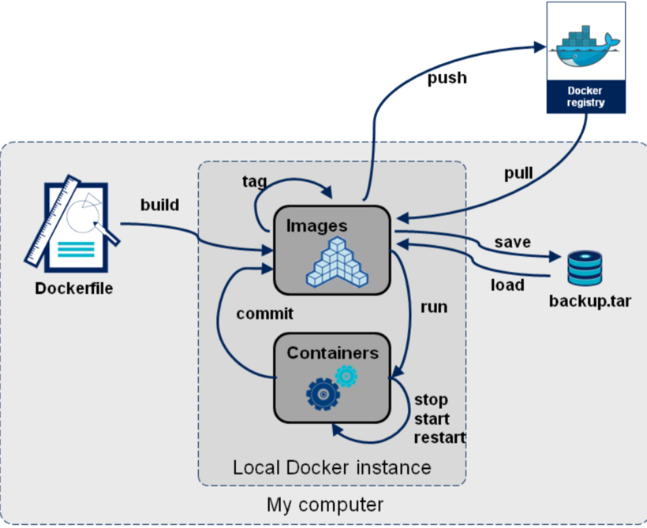
How Docker is used ?
Notes:
Registry is usually/often DockerHub
Registries can be public or private
Dockerfile – text file with all of the instructions for pulling an image, updating it, adding users, etc

Slide 11
What is Singularity?
YACP (Yet another container platform)
Why are we talking about Singularity at all?
How is it different from Docker?
How does this all come together?
Singularity can use Singularity containers from the Singularity Hub or Docker containers, even pulling from a Docker registry like Docker Hub
Notes:
Docker was created with single host/single user in mind – hence it needs access to the host machine’s kernel and needs to run with escalated privileges. To scale workloads up, you may need to move to an HPC cluster and it’s highly unlikely that they’re going to give you root access. You can either find a way around that or get used to running your workloads on your laptop or lab PC.
Singularity was created to run containerized applications in HPC environments – it’s one of the most popular, if not THE most popular methods for running containerized HPC workflows
Key difference – allows untrusted users to run untrusted containers -- your container processes run as you and you never receive any escalated privileges, which should keep container usage from being a security issue.
Singularity complies with the Open Container Initiative – concentrating from the start on interoperability with Docker

Slide 12
Moving into the first exercise…
Simple container creation!
Questions?

